Slide 1
Human Scream Detection AI
Subtitle: AI-Powered Audio Analysis for Emergency Detection

Slide 2
Problem Statement
Why Scream Detection is Important
Screams are one of the most universal signals of fear, danger, or distress across all cultures.
In critical situations (crime, accidents, medical emergencies), a scream is often the only signal for help.
Safety, security, and healthcare applications require quick response systems to identify such distress signals.

Slide 3
Current Gap
Traditional surveillance systems rely on CCTV and manual monitoring, which may fail to detect screams in time.
No widely available automated solution for real-time scream recognition.
Existing audio detection systems are often limited to music/speech recognition, not distress sounds.

Slide 4
Need for AI-powered Scream Detection
Provides 24/7 automated monitoring without human intervention.
Can trigger instant alerts in public spaces, hospitals, and smart homes.
Enhances safety by acting as an early-warning system during emergencies.

Slide 5
Objectives
Primary Objective
To design and develop an AI-powered system capable of accurately distinguishing between screams and non-scream sounds.
Technical Objectives
Implement machine learning models (Logistic Regression, Decision Tree, Random Forest) and evaluate performance on audio data.
Extract meaningful audio features (MFCCs, Spectrogram, Zero Crossing Rate, RMS) for robust classification.
Reduce noise and improve detection accuracy through data preprocessing and feature selection.

Slide 6
Dataset
Dataset Sources
Collected audio samples of scream and non-scream sounds.
Balanced dataset ensuring equal representation of both classes.
Audio formats standardized to WAV/MP3 with fixed sampling rate.

Slide 7
Preprocessing Techniques
Data Cleaning
Removed corrupted/missing audio files.
Normalized audio signals for consistent amplitude.
Feature Extraction
MFCCs (Mel Frequency Cepstral Coefficients): capture frequency domain features.
Spectrograms: visualize frequency vs time.
Zero Crossing Rate (ZCR): detects abrupt changes in sound.
Root Mean Square Energy (RMS): captures intensity of the audio.
Label Encoding
Assigned 1 = Scream, 0 = Non-Scream for classification.

Slide 8
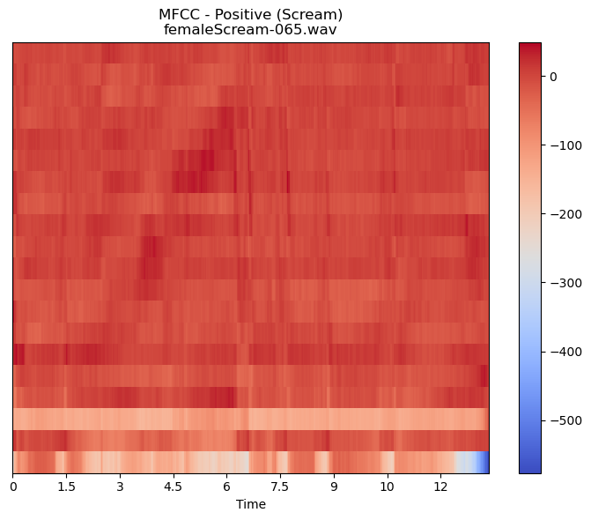
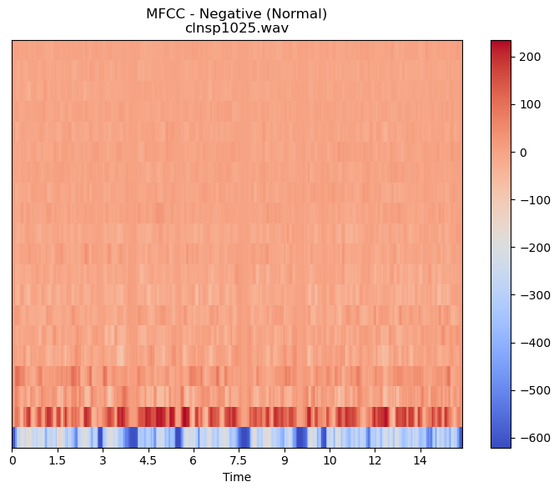
EDA & Visualization
Audio Fingerprints: Normal Voice vs. Scream
We can visualize the unique characteristics of a sound using Mel-Frequency Cepstral Coefficients (MFCCs). Think of the plots below as the "fingerprint" of each audio clip. These visual differences are exactly what a machine learning model uses to tell sounds apart.

Slide 9
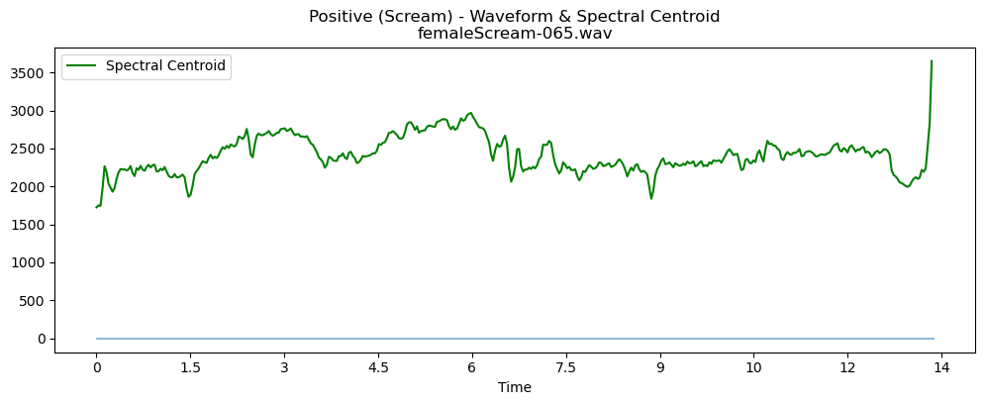
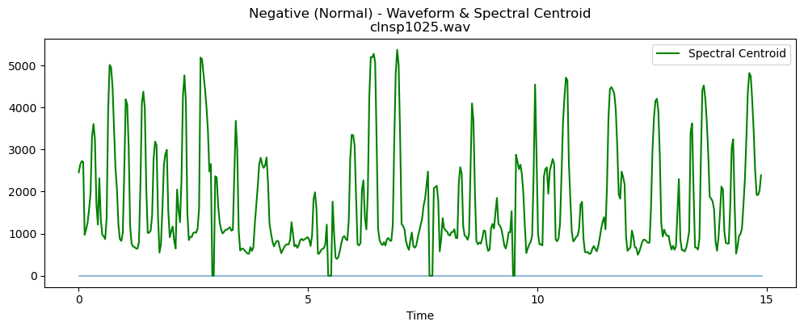
EDA & Visualization
Analyzing Sound's 'Brightness': The Spectral Centroid
The Spectral Centroid is a feature that helps us locate the "center of mass" of a sound's frequencies. Think of it as a measure of a sound's brightness. A sound with a higher spectral centroid is perceived as brighter or more piercing, like the hiss of a cymbal, while a sound with a lower one is duller, like a bass drum.

Slide 10
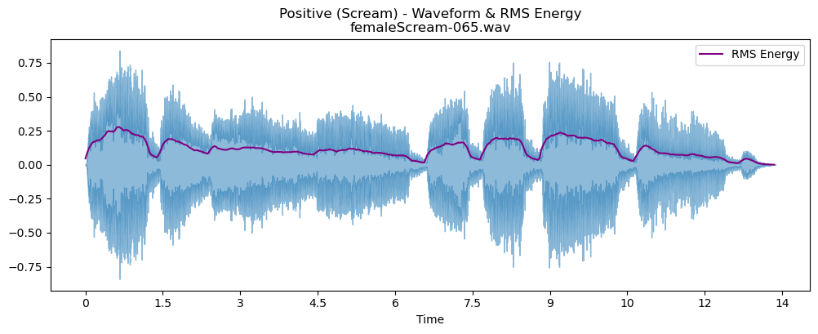
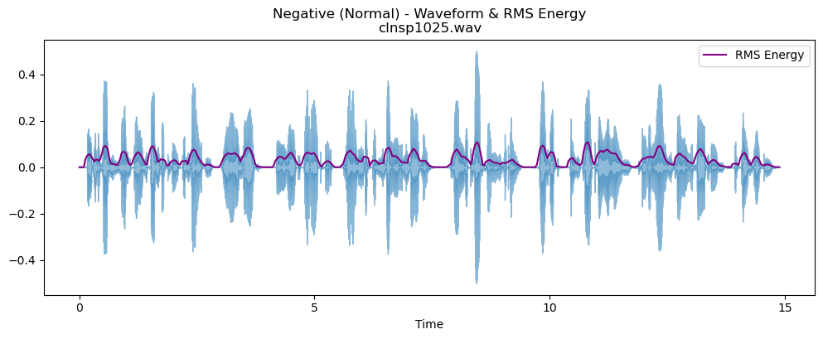
EDA & Visualization
Measuring Loudness: RMS Energy
RMS (Root Mean Square) Energy is a standard way to measure the loudness or power of an audio signal over time. A higher RMS value simply means a louder, more powerful sound. This is one of the most fundamental features for distinguishing between different types of audio events.

Slide 11
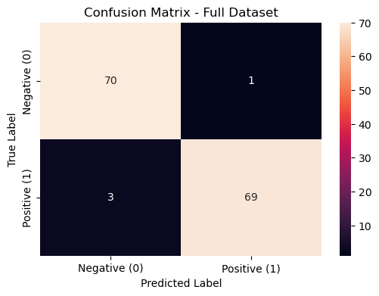
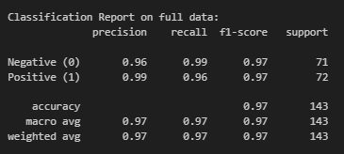
Model Performance: Logistic Regression Results
To classify the audio features, we utilized a Logistic Regression model. This is a reliable and efficient algorithm for binary classification (Scream vs. Normal). The model's performance on our dataset was excellent, demonstrating high accuracy and reliability.

Slide 12
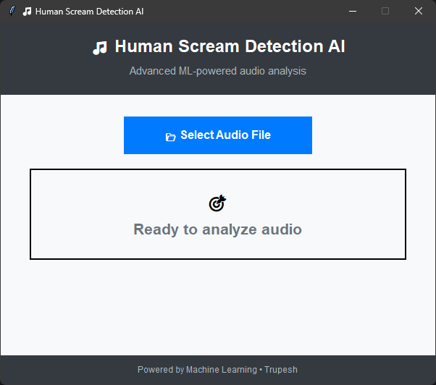
Application
Overview of Application
Developed using Python Tkinter for GUI.
Integrated with Pygame for audio playback.
Connected to trained ML model for scream classification.

Slide 13
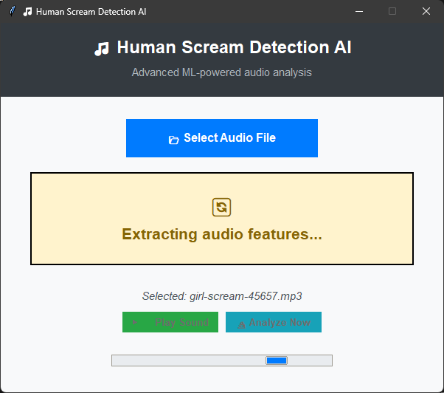
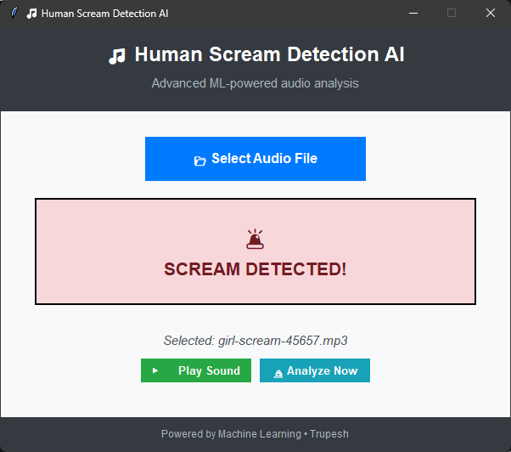
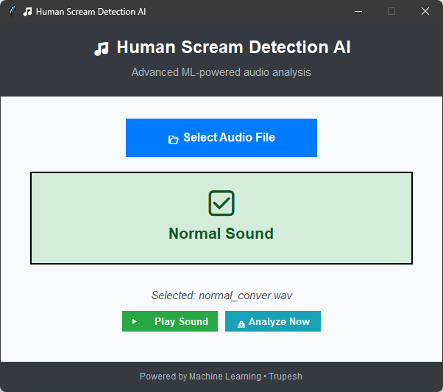
Application

Slide 14
Conclusion
Developed an AI-based system to detect human screams from audio.
Compared multiple ML models → Random Forest performed best.
Built a Tkinter GUI: upload, play & analyze audio.
Provides instant alerts ( Normal / Scream).
Useful for safety, healthcare & surveillance applications.

Slide 15
Future Work
Real-time Detection → Enable continuous monitoring using microphone input.
Deployment → Extend system to mobile & web apps for wider adoption.
IoT Integration → Connect with CCTV & smart devices for instant alerts.
Extended Scope → Detect other distress sounds like crying, shouting, gunshots.
Scalability → Optimize for large-scale use in public safety & healthcare systems.

Slide 16
Any questions?
Ask away!

Slide 17
Thank you

